Slide 1
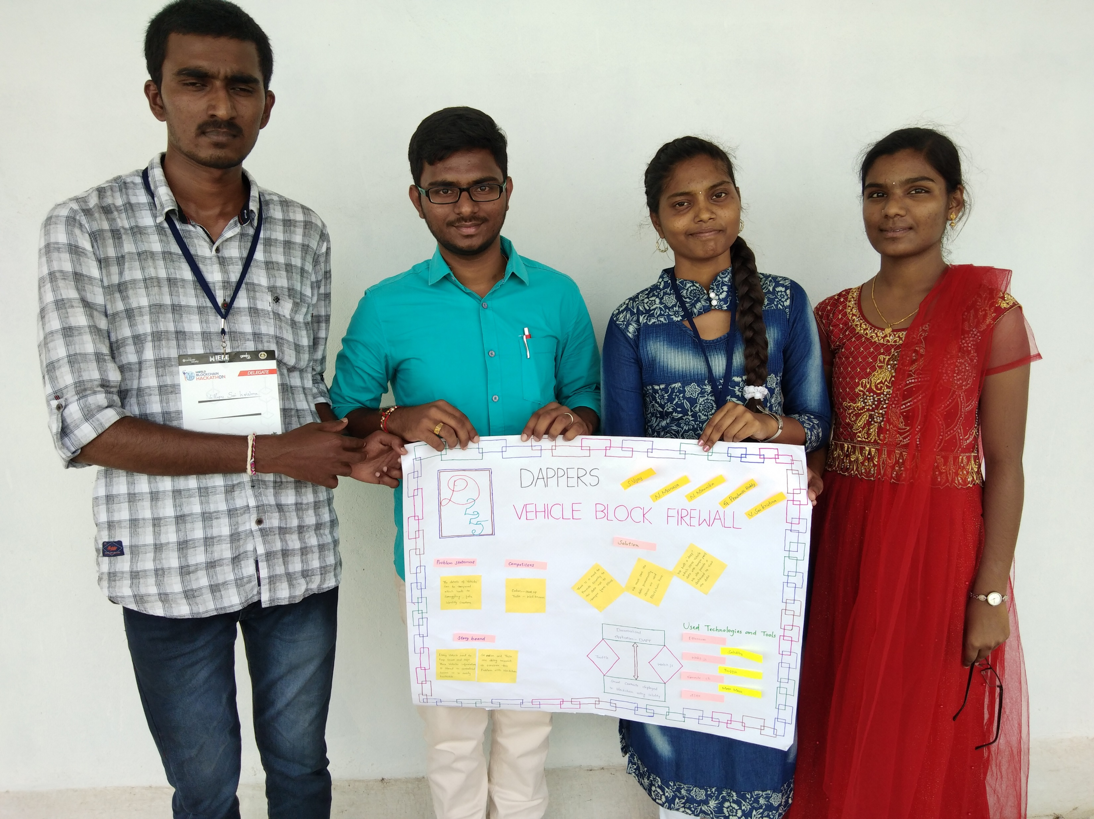
TEAM 225 - DAPPERS
…….
VEHICLE BLOCK FIREWALL
TEAM
S Vijay
G Prashanth Reddy
V Sai Krishna
N Mounika
N Manasa

Slide 2
Introduction
Our Project is a Decentralized Application which resolves the problem of insecurity had to vehicle details of our eco-system. We made dApp to secure the details in a Blockchain.

Slide 3
Problem identified
The motivation to do dApp is to secure details of vehicles because of these –
Tampering the registration details of vehicles.
Creating fake identity issuance cards.
Smuggling the vehicles illegally.
The data of features are made trustable

Slide 4
Effect of these problems to the society
It’s higher threat of not paying proper taxes to government on buying smuggled vehicles.
If a vehicle license is tampered to utilize for others, then the motive of having driving licenses disturbs.
To buy a vehicle, we are depending to trust the third parties to know features.
The data of vehicles stored now in centralized servers can be hackable and vulnerable to natural disasters.

Slide 5
Benefits if we resolve mentioned issues
If the data of vehicles are stored in a decentralized server like blockchain, smuggled vehicles are easily identified to traffic authorities.
No tamper of license cards can be encouraged to citizens as we have a secure database of each vehicle.
No need to depend on third parties to know the features of vehicle as we have a secure and trustful data stored in blockchain.
As we deploy the whole data in a blockchain, no hacking can be done.
We can retrieve the data even it lost by means of disasters.
The data we have can be useful to predict the accurate performance of each company vehicle.

Slide 6
The reason we have to choose blockchain to solve the issue –
Blockchain is permanent ledger.
It is decentralized network, universal update and retrieve of data.
It is a decentralized database.
It’s secure and uses SHA256 encryption algorithm.

Slide 7
How we made
Decentralized Application
DApps
??
Frontend – Web3.js and AJAX
Meta-
mask
Ganache-cli
Smart Contracts deployed in Ethereum Blockchain using Solidity and Truffle.

Slide 8
What we made ?
We pushed the details of vehicles in Ethereum blockchain. Details like
Vehicle Identification Number
Vehicle Model
Vehicle Plate Number
Bought Amount
Owner of vehicle
Other features
We retrieved such details to the D-App dashboard using web3.js, AJAX, truffle, ganache-cli, Metamask and other tools.

Slide 9
Future Work
We can collect the traffic details and update in blockchain which is useful others not to choose that path.
Calculated measurements like speed, fuel consumed, distance, AC usage and other devices usage, etc., which is used to predict the performance of a vehicle in an accurate manner.
By using the concept of crypto currencies, we can actually write smart contracts in such a way that vehicle can automatically pay to vendors.
By tracking the vehicle location and updating in blockchain, victims cannot fraudulent the proof we have in blockchain.

Slide 10

Thank you Vaagdevi and WBH

